Slide 1
CAPSTONE ON STUDENTS DROPOUT AND SUCCESS RATE
SUBMITTED BY,
AKSHAY S
PGDA-28

Slide 2
PROBLEM STATEMENT
From the dataset given try to find out the various factors which influence the dropout and success rates of students.
Which specific features are related with the above mentioned success and dropout rates?
How do different features interact with each other?

Slide 3
DESCRIPTION
This dataset provides a comprehensive view of students enrolled in various undergraduate degrees offered at a higher education institution. It includes information that can be used to analyze the possible predictors of student dropout and academic success.
This dataset contains multiple columns consisting of relevant information such as application mode, marital status, course chosen and more. Additionally, this data can be used to estimate overall student performance at the end of each semester by assessing curricular units credited/enrolled/evaluated/approved as well as their respective grades.
Finally, we have unemployment rate, inflation rate and GDP which can help us further understand how economic factors play into student dropout rates or academic success outcomes.
Here we look at what factors decide on the success and dropout of students.

Slide 4
METHODOLOGY
Here at first we clean the data which is also known as EDA. We make sure to delete the unwanted columns and also take care of outliers and missing values.
Next we convert all the categorical columns to numbers as we have to perform ML algorithms on them.
After that we perform feature selection and also standardize the dataset.
Later we perform the various tests on the data and build corresponding models to see which model gives higher accuracy.
Then we select the suitable model which can then be used to make better predictions.

Slide 5
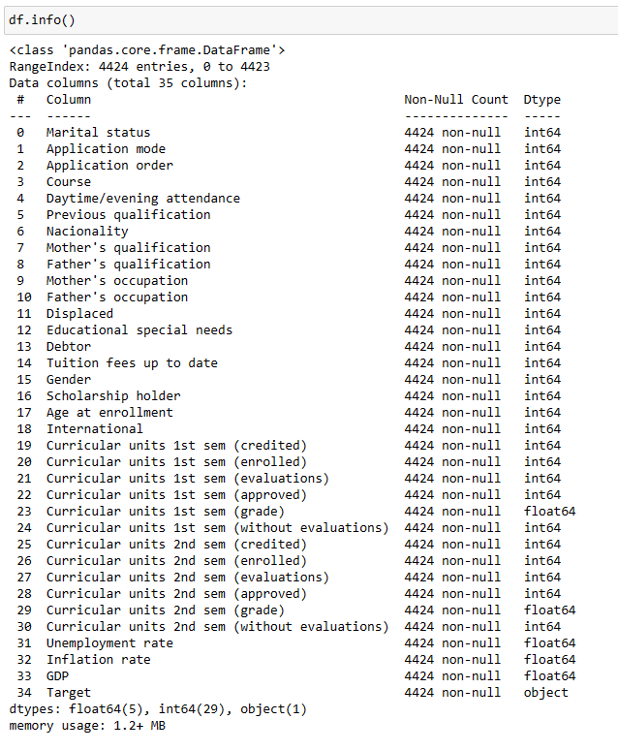
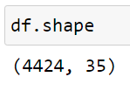
STATISTICAL DESCRIPTION

Slide 6
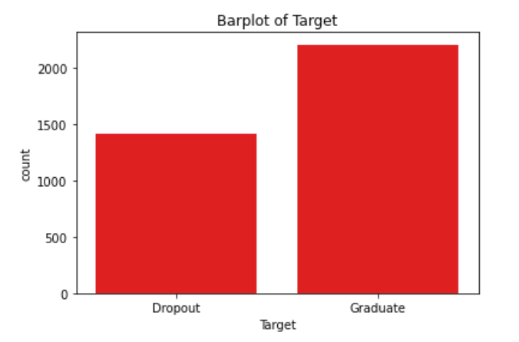
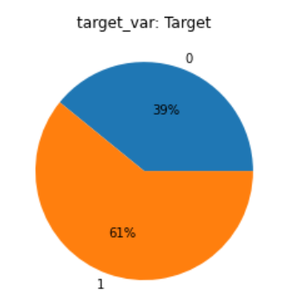
TARGET VARIABLE
While handling the target variable which is categorical we convert it into numerical using Label Encoder which assigns Dropout as 0 and Graduate as 1

Slide 7
FEATURE SELECTION & STANDARDIZATION
Feature Selection is done using Correlation Analysis, Chi-square test and VIF(Variance Inflation Factor).
After Feature Selection we get a new updated dataset containing 18 columns and 3630 rows.
Next we have to standardize the dataset which helps to improve accuracy and stability of machine learning models.
For standardization we use the standard scaler which ensure the features are on similar scale, making them more comparable and reducing influence of individual features which may have disproportionate impact on the model.

Slide 8
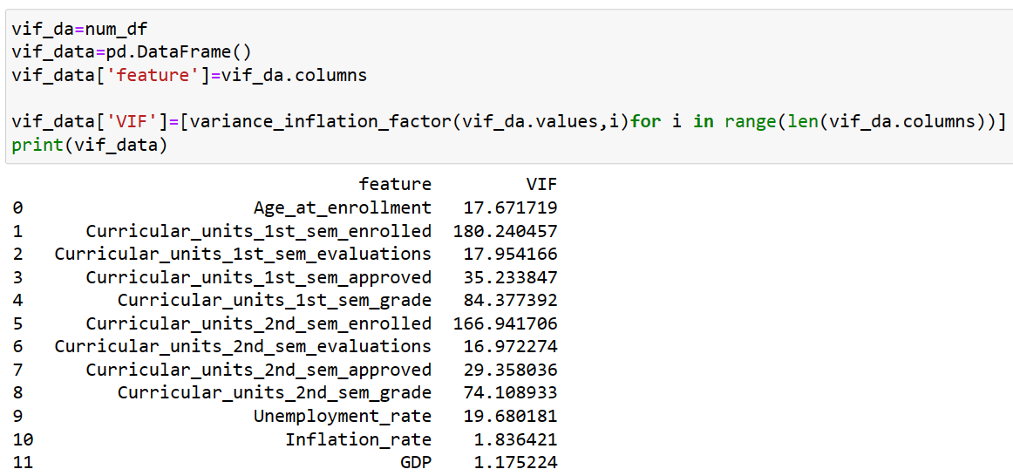
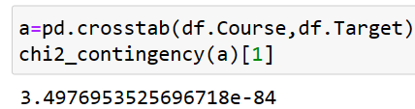
Variance Inflation Factor
Chi-Square Test

Slide 9
MULTIPLE MODELS AND THEIR ACCURACY SCORES
The first model we build is of Logistic regression.
On analysis of data and building the model we get an accuracy score of 76% which can be considered as a good value.
The next model is built using Random Forest.
This model gives us an accuracy score of 76.58% which is slightly higher than the previous model.
The next algorithm used is Decision Tree.
This gives us an accuracy of 71.53%.

Slide 10
SVM is the next algorithm that we use to make the model.
It gives us an accuracy score of 66%.
Naives Bayes is another algorithm that we use.
It gives an accuracy score of 74.1%.
Next we use the KNN algorithm. When using ball tree method an accuracy of 66.48% is obtained and for kd tree method we get accuracy of 74%.
Next we using boosting algorithms like Ada Boost, Gradient Boost and XG Boost.
The accuracy scores are as follows:
Ada Boost:77.50%
Gradient Boost:78.78%
XG Boost:79.52%

Slide 11
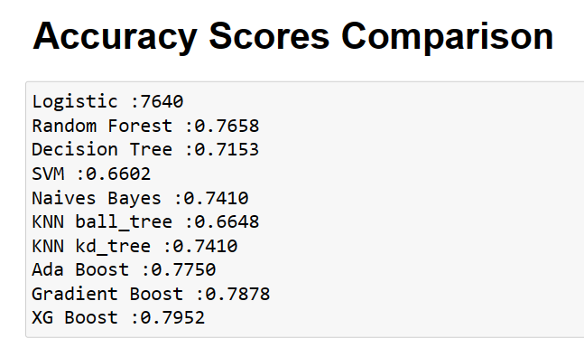

Slide 12
SUMMARY
We tried to build a model which helps us understand what are the various factors that affect the performance of students and lead to their success or dropout.
For that first we tried to understand the data.
Then visualized and handled the data appropriately.
Corrected outliers and dropped unwanted columns while doing feature selection.
Finally built various models and evaluated their performances. Found out which has highest accuracy score and can be used to solve our business problem,

Slide 13
KEY FINDINGS
While comparing all the models that we have built so far using all the algorithms we can see than the XG Boost model gives the best output.
The XG Boost Classifier model gives us an accuracy of 79.52%.
So we can make use of this algorithm to solve our business problem and find out what factors influence the success and dropout rates of the students.

Slide 14
HOW USEFUL FOR BUSINESS
This model helps us understand what are the various factors that affect the performance of students and lead to their success or dropout.
This model can be used to make better decisions and try to increase the success rate of students and find ways to slowdown the dropout rate.
It helps us understand how different features interact with each other.

